Slide 1
Office Fabric UI Meets The Microsoft Graph API

Slide 2
Agenda
Office Fabric UI Fundamentals
Office Fabric UI with SharePoint-hosted add-ins
Microsoft Graph API Fundamentals
Mixing Office Fabric UI and Microsoft Graph API

Slide 3
Introduction Office Fabric UI
What is it?
a mobile-first, front-end CSS framework for developers
Uses HTML, CSS, theming, iconography, and patterns
Can be used to compliment or replace bootstrap
Why use it?
Standardize UI patterns in code across projects
Create UI experiences look and feel like the Office UI
Where to use it?
SharePoint add-ins
Office add-ins
Office 365 applications

Slide 4
Office Fabric UI Features
Typography
Color
Icons
Animations
Responsive grid
Localization support

Slide 5
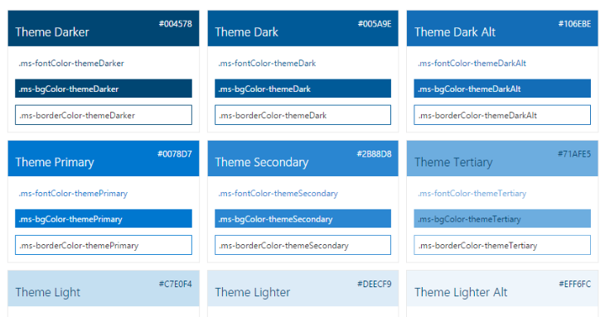
Theme Support

Slide 6
Components
Input Components
Layout components
Navigation components
Content components

Slide 7
Input Components
Buttons
Choice fields
Date Picker
Form field label
Search Box
Toggle
Text fields

Slide 8
Layout Components
List
Dialog box
Callout

Slide 9
Navigation Components
Navigation bar
Pivots

Slide 10
Content components
Persona
Persona card
List item
Table

Slide 11
Starting with an Angular App

Slide 12
Agenda
Office Fabric UI Fundamentals
Office Fabric UI with SharePoint-hosted add-ins
Microsoft Graph API Fundamentals
Mixing Office Fabric UI and Microsoft Graph API

Slide 13
Moving on to a SharePoint-hosted Add-in

Slide 14
Agenda
Office UI Fabric Fundamentals
Office UI Fabric with SharePoint-hosted add-ins
Microsoft Graph API Fundamentals
Mixing Office UI Fabric and the Unified API

Slide 15
Office 365 API Endpoint in Initial Release
Azure Endpoints
Azure Graph API
Azure Discovery Services
Office 365 API Endpoints
Outlook service
OneDrive for Business Service
SharePoint Files Service
Discovery Service
https://api.office.com/discovery/v1.0/me
Azure AD Data
Users
Groups
Azure Active Directory Graph API
https://graph.windows.net/CptClassroom1.onMicrosoft.com
Your
Office 365
Application
Outlook Data
Mail
Calendar
Contacts
Outlook Service
https://outlook.office365.com/api/v1.0/
OneDrive for Business Service
https://myTenant-my.SharePoint.com/personal/TedP/_api/v1.0/Files
SharePoint Data
OneDrive Files
Team Site Files
SharePoint Files Service
https://myTenant.SharePoint.com/_api/v1.0/Files

Slide 16
Office 365 Unified API aka Microsoft Graph
Designed as a single, more-comprehensive service
Abstracts away divisions between AD, Exchange and SharePoint
No need to discover endpoints using the Discovery Service
Acquire and cache an a single access token per user
Azure AD Data
Users
Groups
Your
Office 365
Application
Outlook Data
Mail
Calendar
Contacts
Office 365 Unified API
https://graph.microsoft.com
SharePoint Data
OneDrive Files
Team Site Files

Slide 17
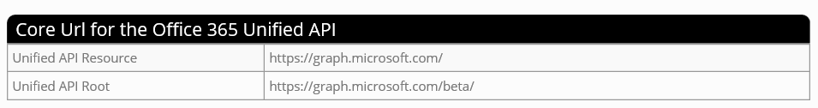
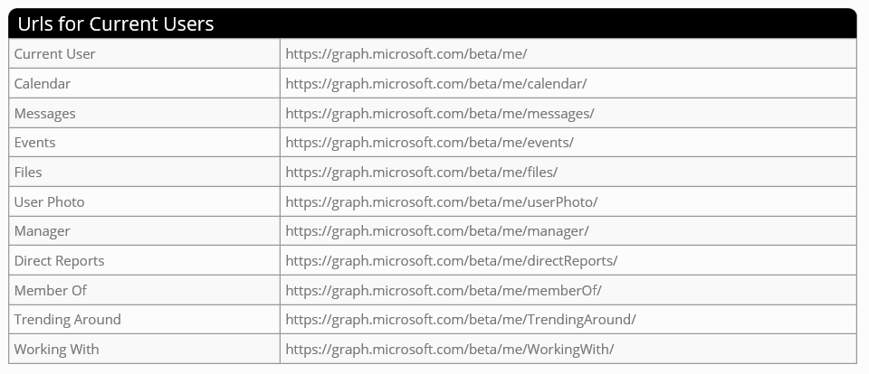
Unified API URLs

Slide 18
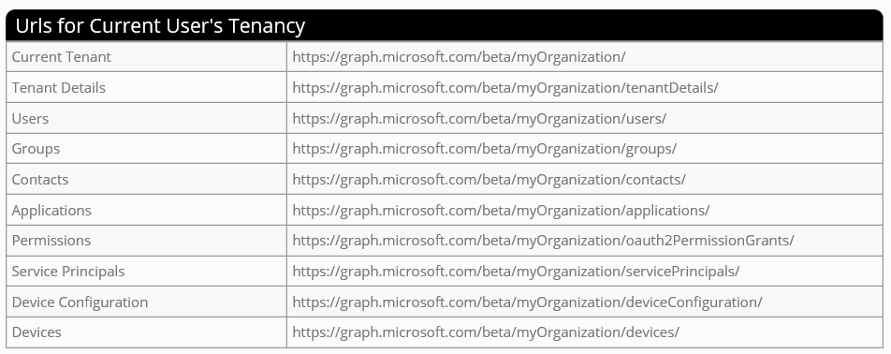
More Unified API URLs

Slide 19
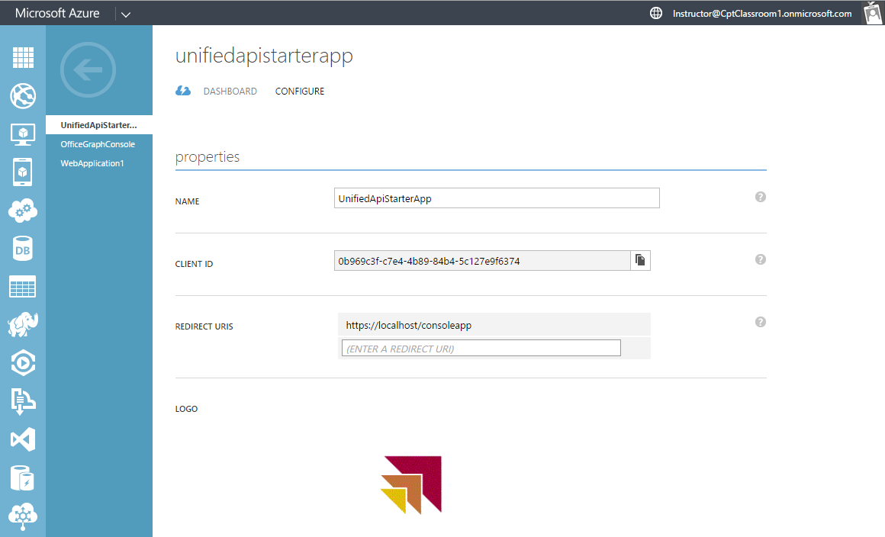
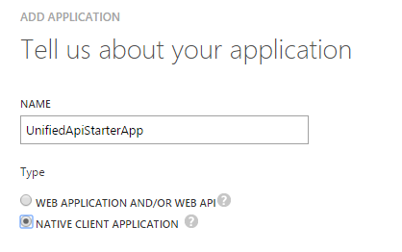
Creating an Azure AD Application
To access the Office 365 APIs…
application must first be registered with Azure Active Directory
Application registered as Web Application or as Native Client
Creating a new AAD Application

Slide 20
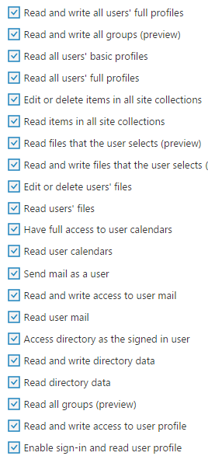
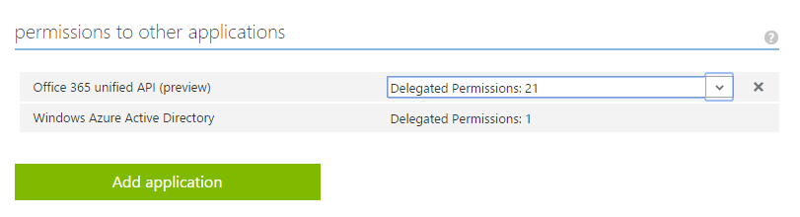
Configuring Unified API Permissions
Application required permissions in AAD
Office 365 tools in Visual Studio tools not updated yet
Permissions configured in Azure Management Portal

Slide 21
Agenda
Office Fabric UI Fundamentals
Office Fabric UI with SharePoint-hosted add-ins
Microsoft Graph API Fundamentals
Mixing Office Fabric UI and Microsoft Graph API

Slide 22
Understanding the Implicit Grant Flow
Implicit Grant Flow
Used when client cannot keep secrets (public client)
Used with SPAs built using JavaScript and AngularJS
Less secure than Authentication Code Grant
How does it work?
Client authorizes user with AD authorization endpoint
AD returns access token directly to SPA in browser
Authentication flow does not involve authorization code

Slide 23
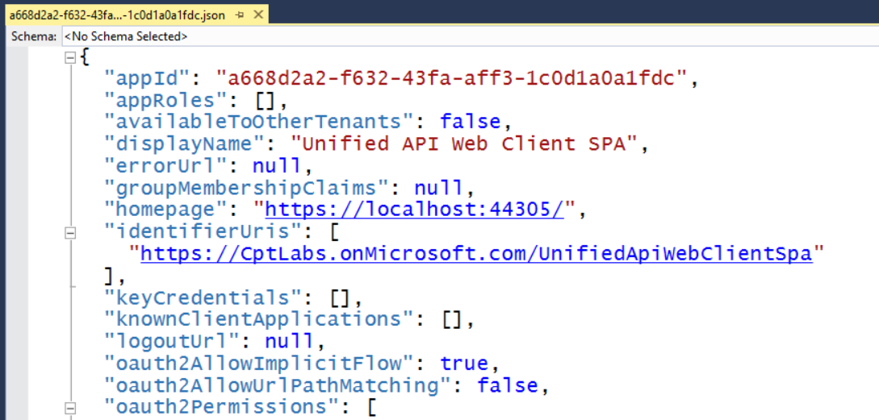
Configuring Implicit Flow in Azure AD
Requires configuring AD application in Azure AD
Download manifest from Azure AD
Update oauth2AllowImplicitFlow setting equal to true
Upload manifest to Azure AD to save changes

Slide 24
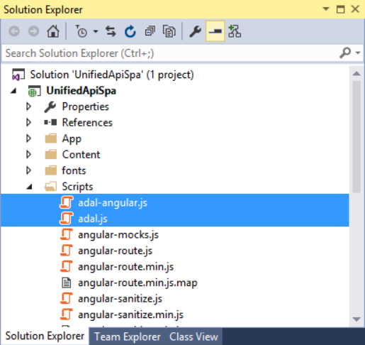
Downloading the ADAL-JS Library
Developing with ADAL-JS involves to two library files
adal.js – core ADAL-JS library
adal-angular.js –integration of ADAL-JS with AngularJS
Library files downloadable from GitHub Repository
https://github.com/AzureAD/azure-activedirectory-library-for-js

Slide 25
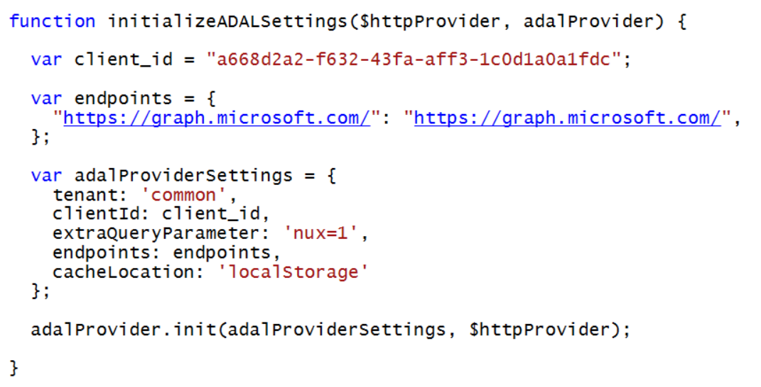
Initializing ADAL-JS Settings

Slide 26
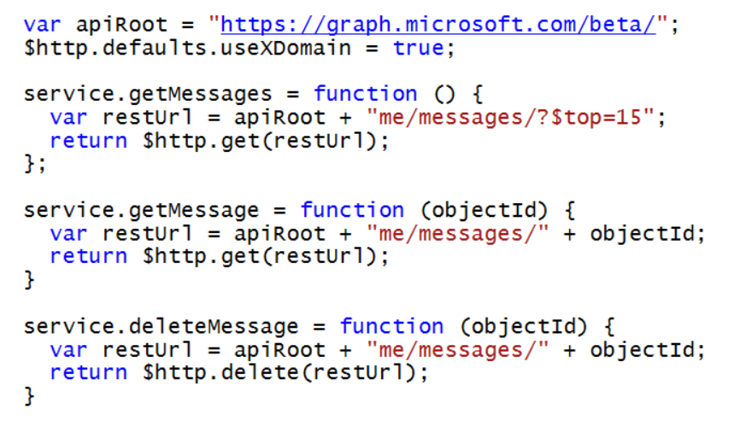
Making Secure Calls to Custom Web Services
adal-angular.js adds interceptors to $http service
adal detects when calls are made to secure endpoints
adal acquires & caches access tokens behind scenes
adal attaches access token to Authorization header

Slide 27
And now finally…. An Office 365 SPA Application

Slide 28
Summary
Office Fabric UI Fundamentals
Office Fabric UI with SharePoint-hosted add-ins
Microsoft Graph API Fundamentals
Mixing Office Fabric UI and Microsoft Graph API

